Slide 1


Akscellence Info
Serving Clients with Excellence

Slide 2

About Us
Provide data driven Business Growth Solutions using power of Data , Analytics, Artificial Intelligence (AI) and Machine Learning (ML)
Our BI & Analytics offerings are :
Data Management/Data Governance
Design & Develop Enterprise Data Warehouse
Data Quality Solutions
Advanced Data Analytics using AI & ML
Predictive Analytics, Optimizers, Text Analytics
Data Visualization using Power BI
Design and develop visual dashboards
Other traditional offerings :
Custom Solutions using Microsoft Technology
Customer Experience Mgmt. using Sitecore
Integration solutions using Web Methods
Staff Augmentation

Slide 3
BI and Analytics Offerings
Our BI and Analytics services help you make the most of your own data, collect and integrate third-party data, and analyze all of it for the benefit of your businesses.
We have unique blend of Data solutions and Basic & Advanced analytics (using AI/ML) to help you setup the complete solution
We will help you:
Automate your Data Collection Process => Reduce Efforts & Reduce Errors
Create Automated and Interactive Visual Analytics from your data (No manual intervention required)
Write Machine Learning Algorithms
Write Prediction Models with Advanced Analytics
Most important we have the capability of building custom applications to meet your specific requirements

Slide 4









Our Clients/Partners

Slide 5

SAMPLE USE CASES

Slide 6
Warehouse Location Optimization (Using Machine Learning)

Slide 7
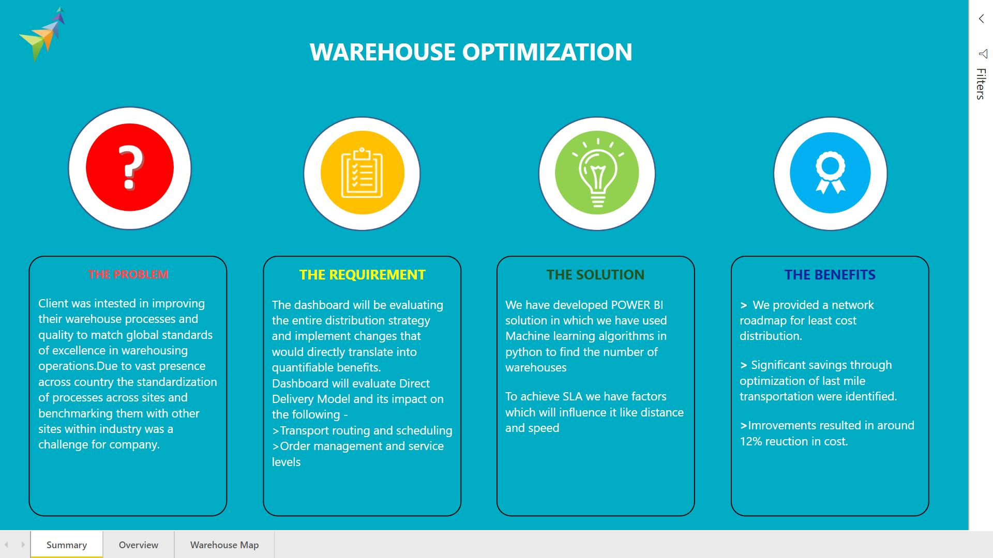

Slide 8
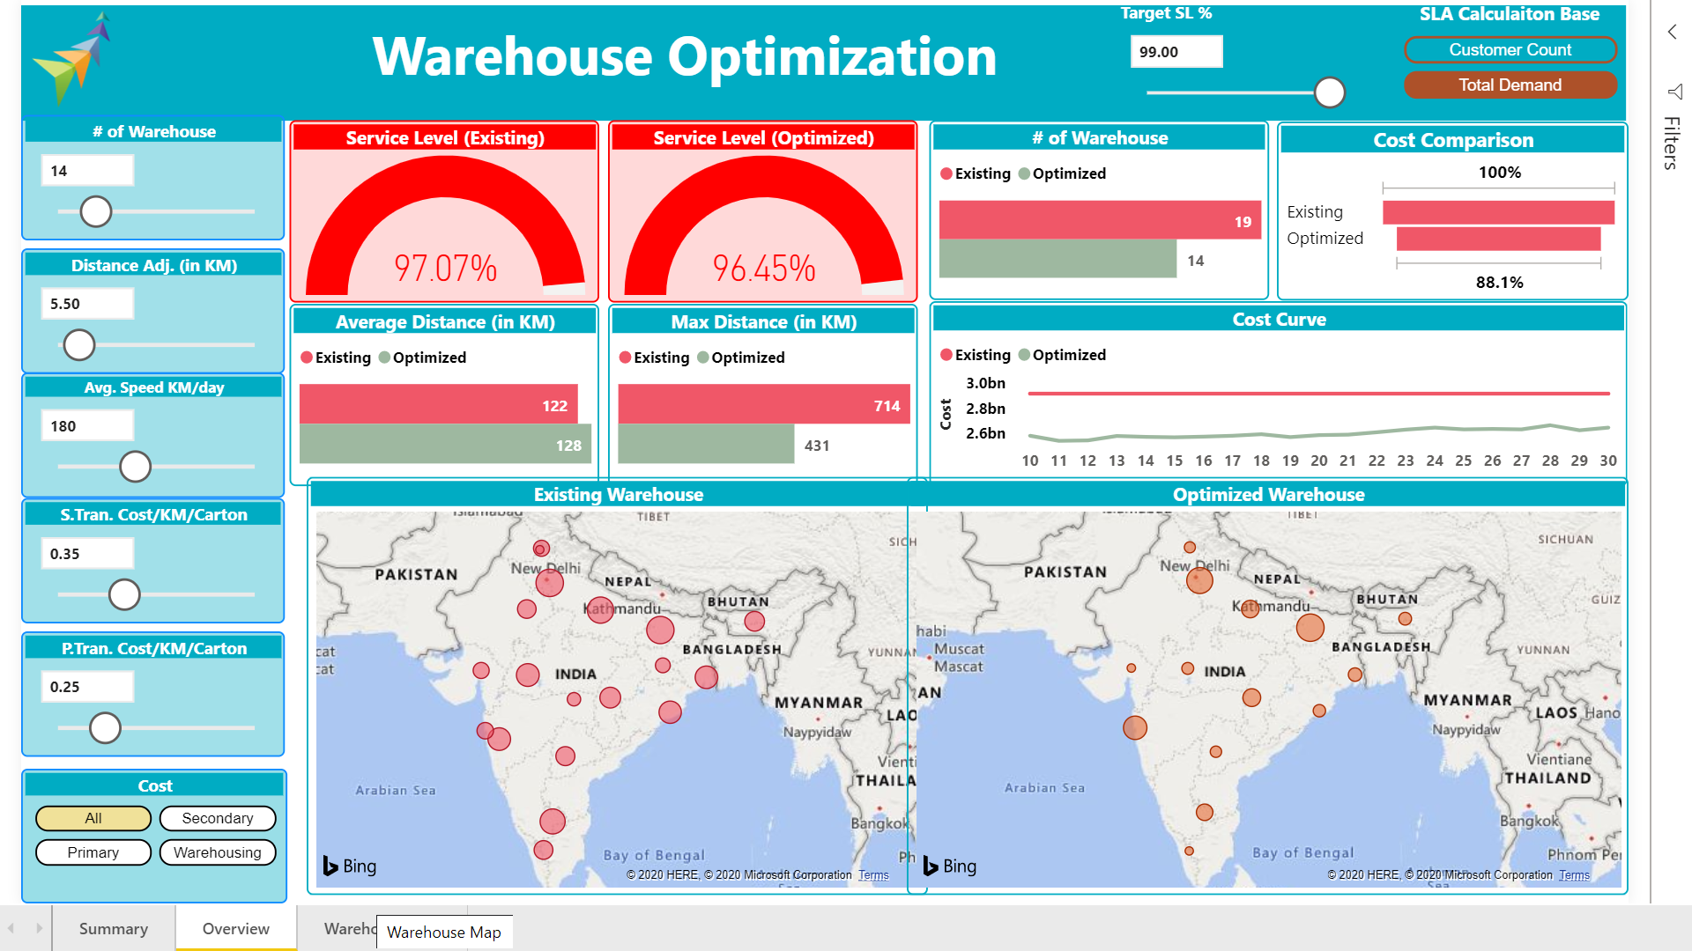

Slide 9
Finance Dashboard (Predictive Analytics)

Slide 10
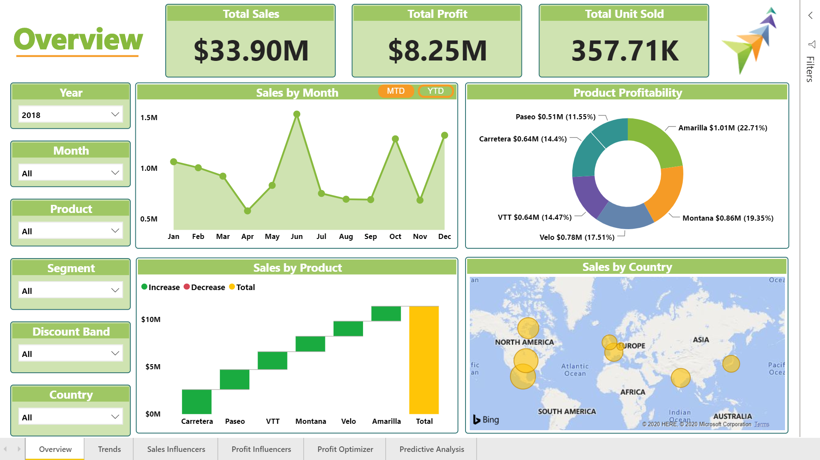

Slide 11
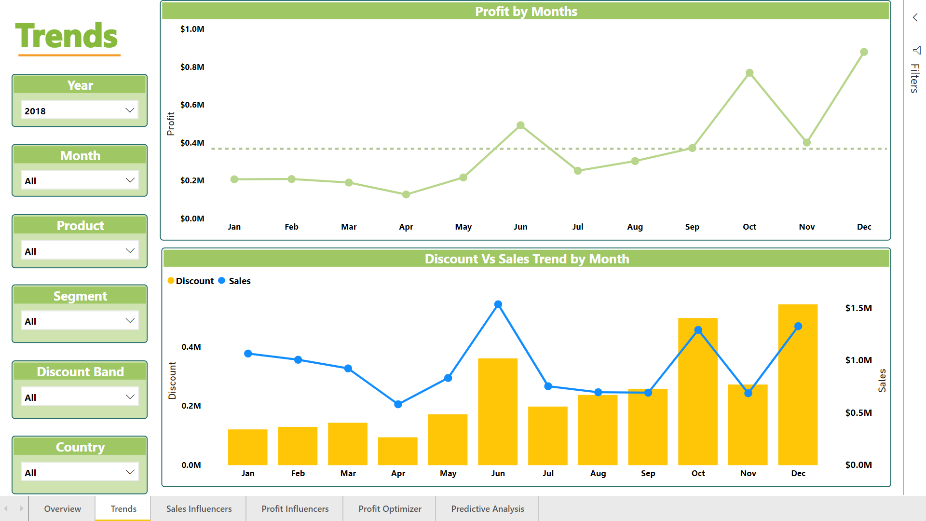

Slide 12
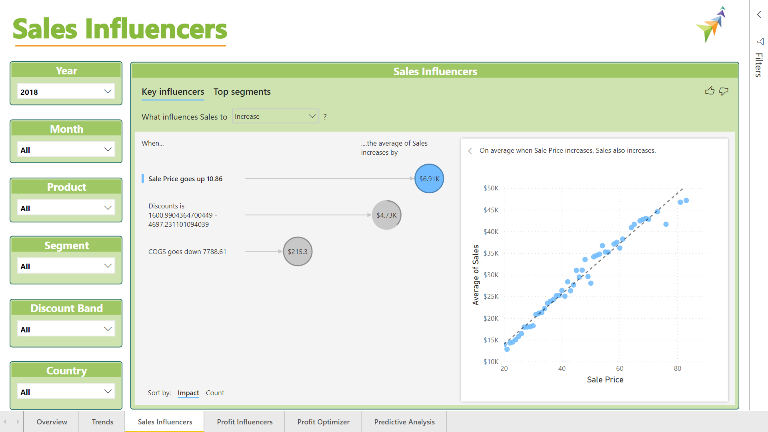

Slide 13
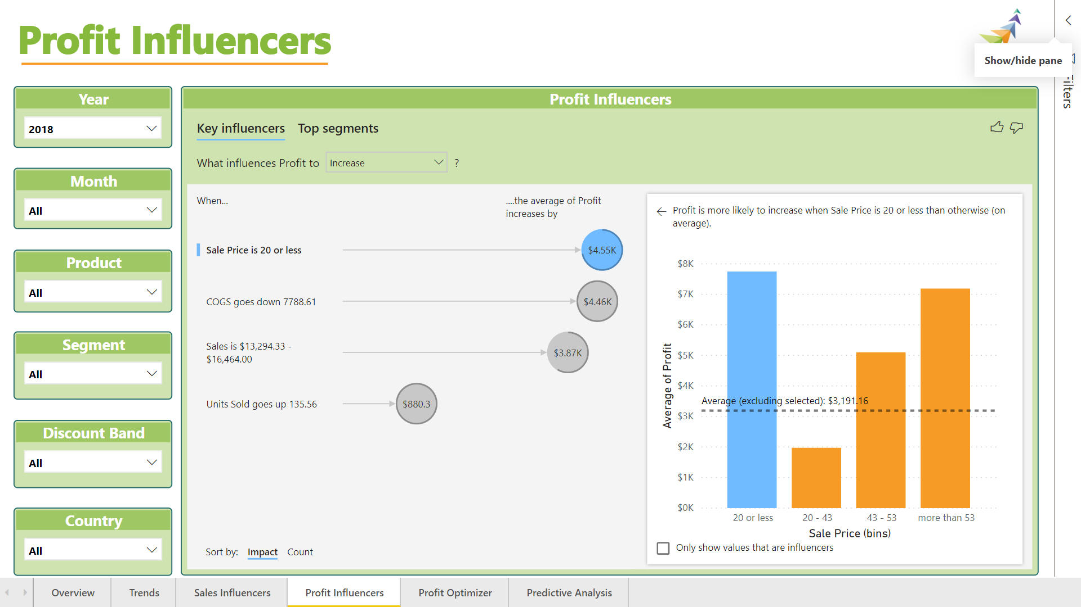

Slide 14
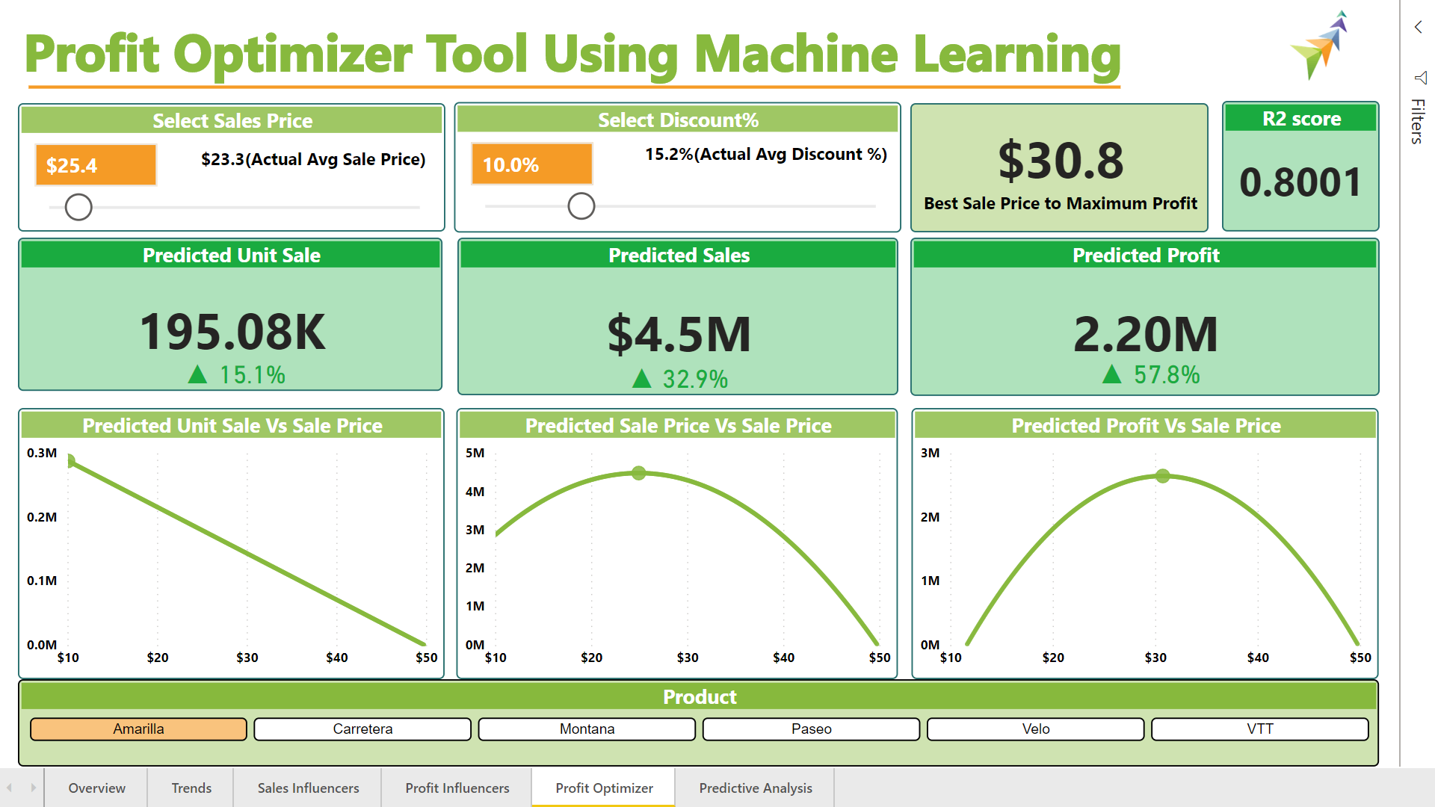

Slide 15
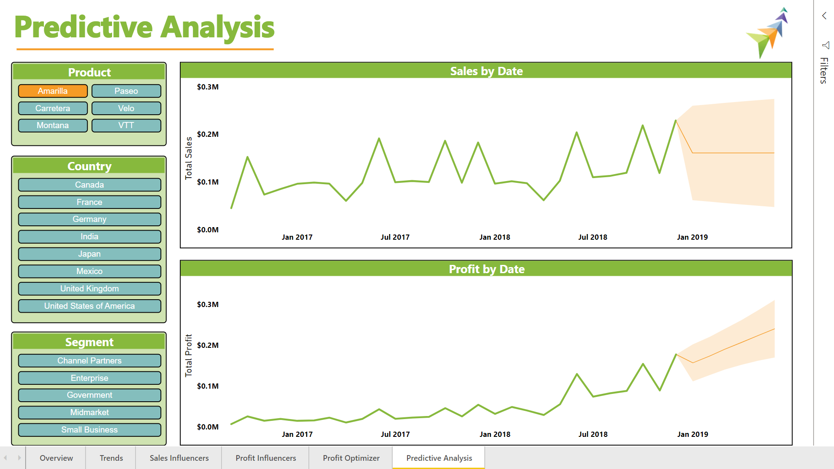

Slide 16
Human Resources Dashboard

Slide 17

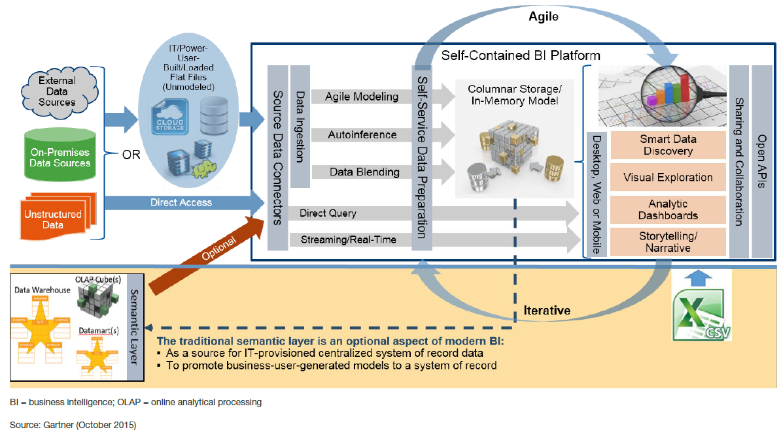
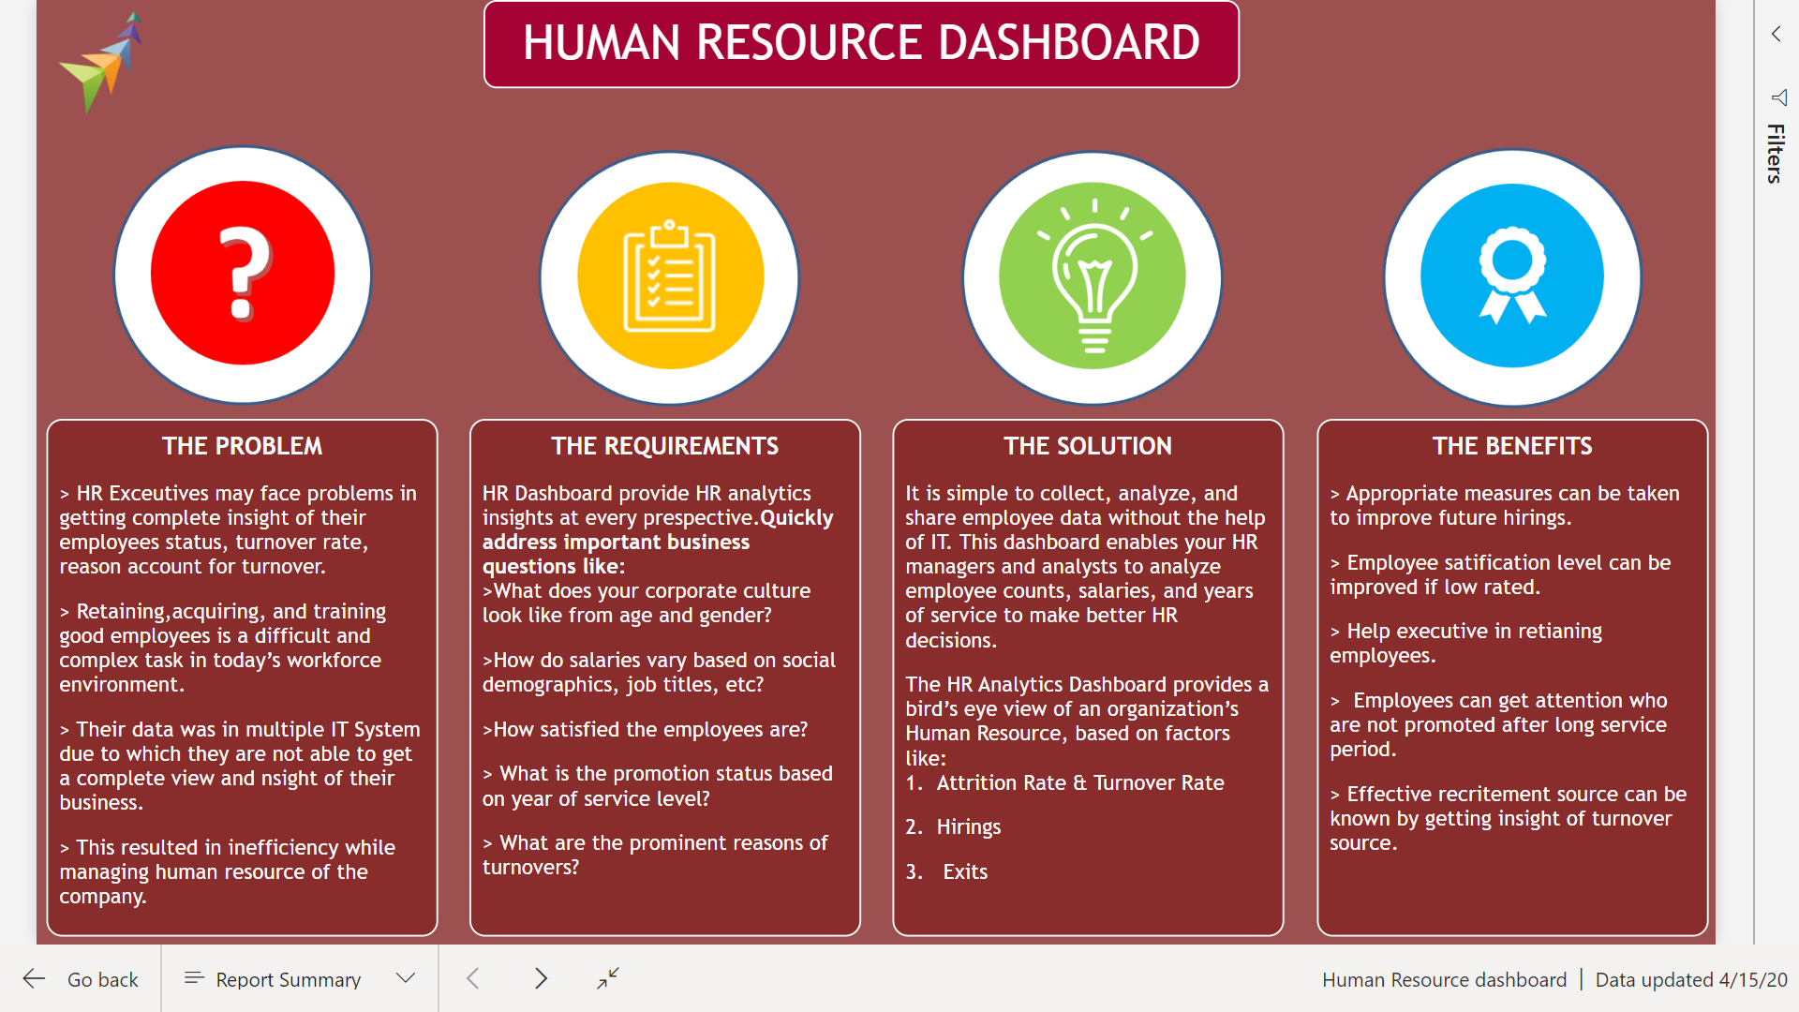
Analytics Solution Architecture

Slide 18
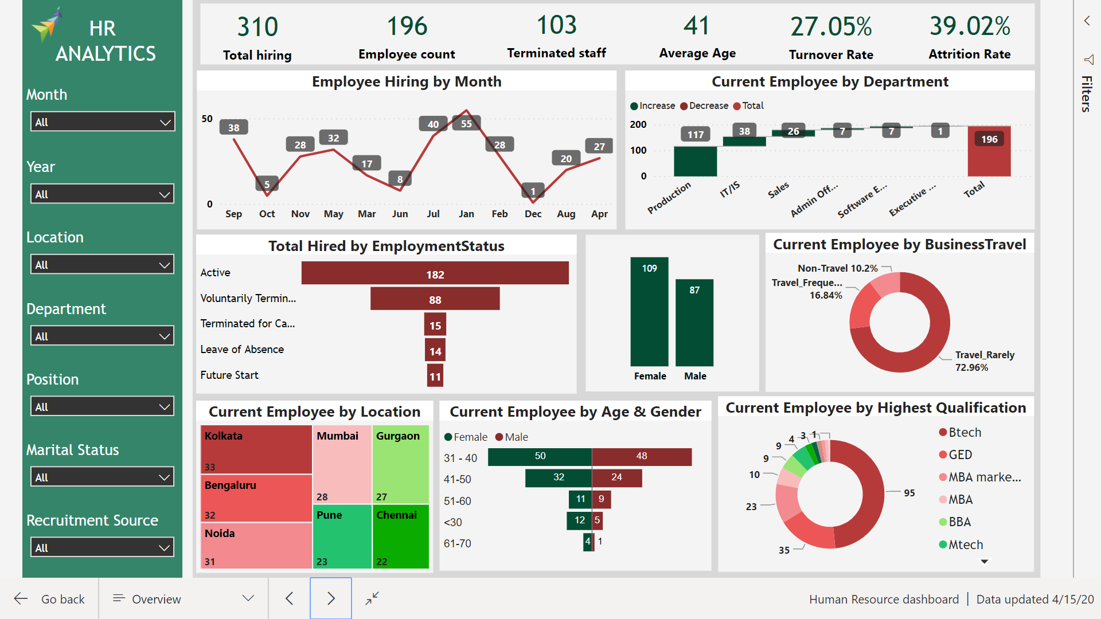

Slide 19
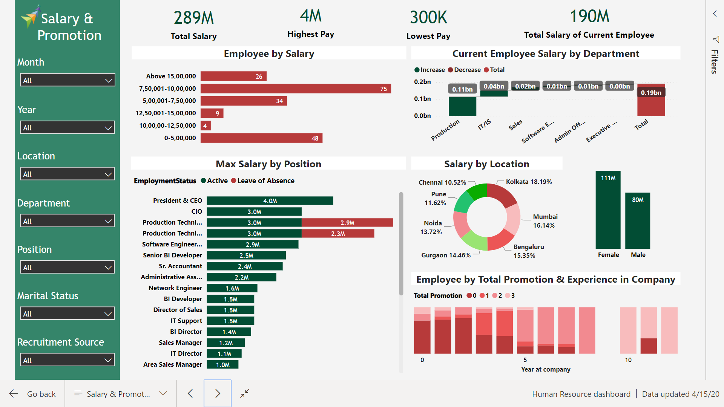

Slide 20
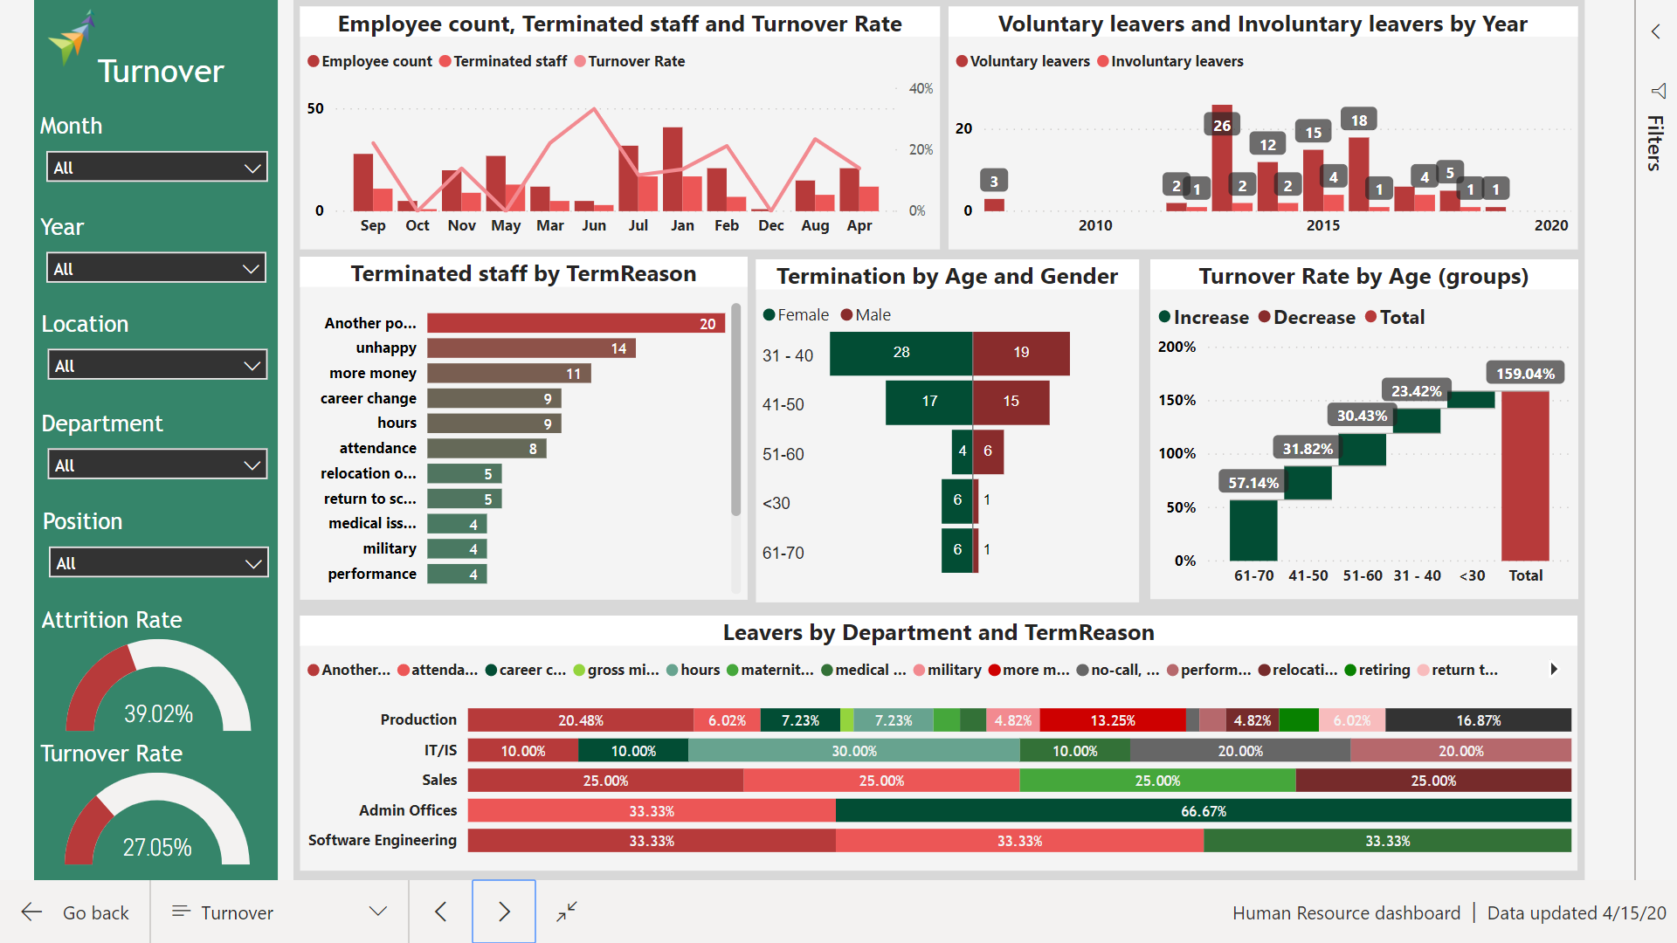

Slide 21
Ticketing System

Slide 22
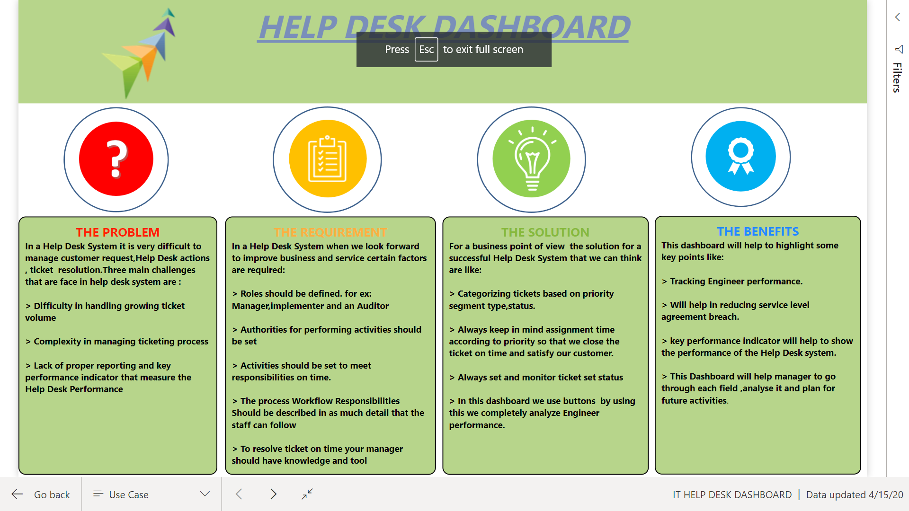
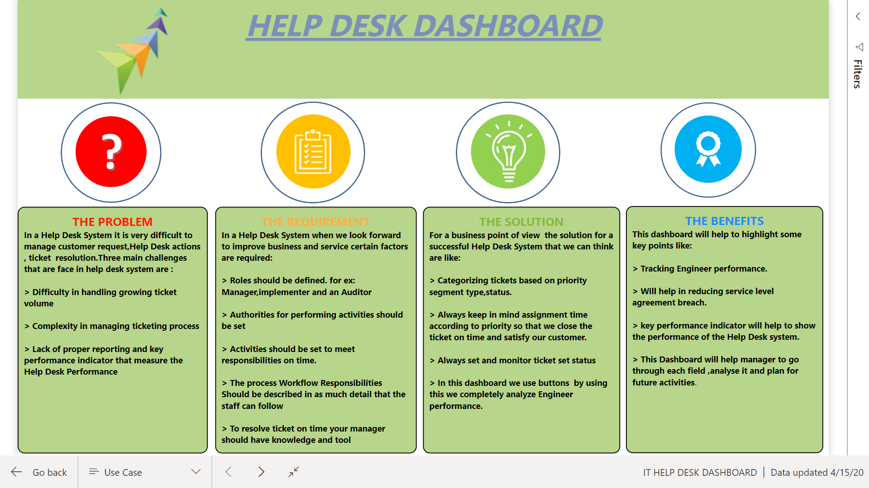

Slide 23
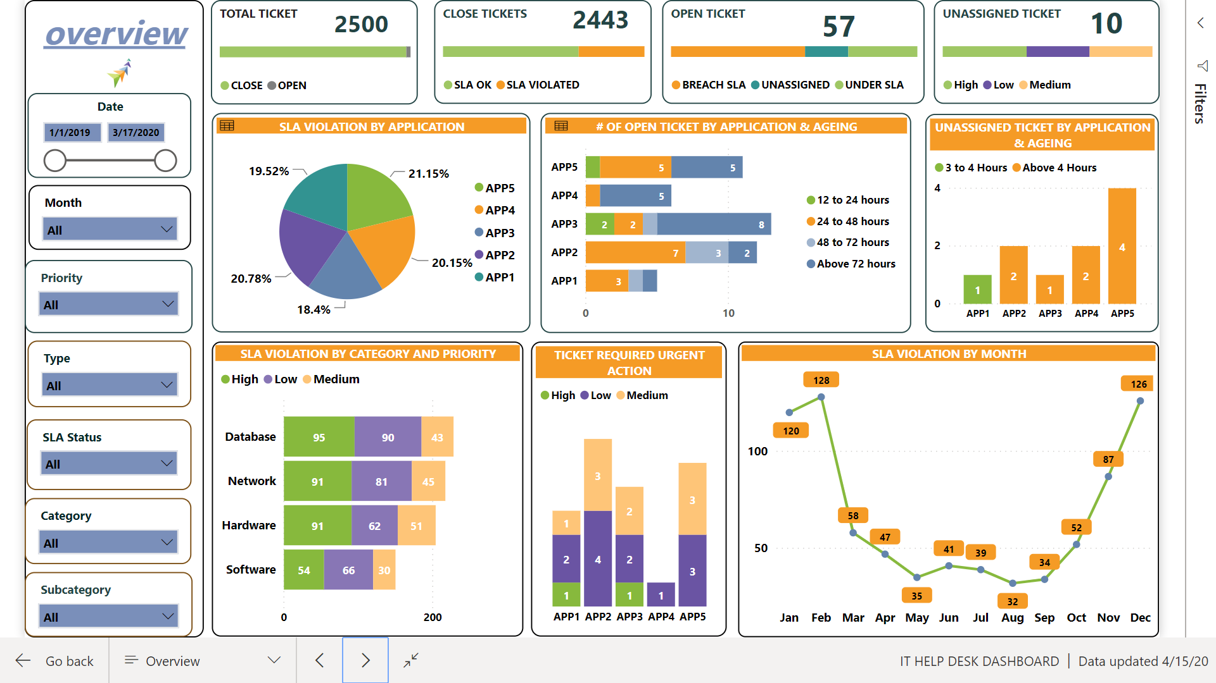

Slide 24
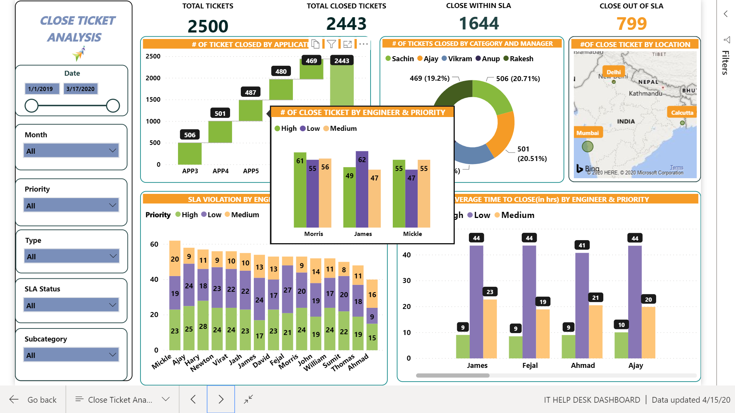

Slide 25
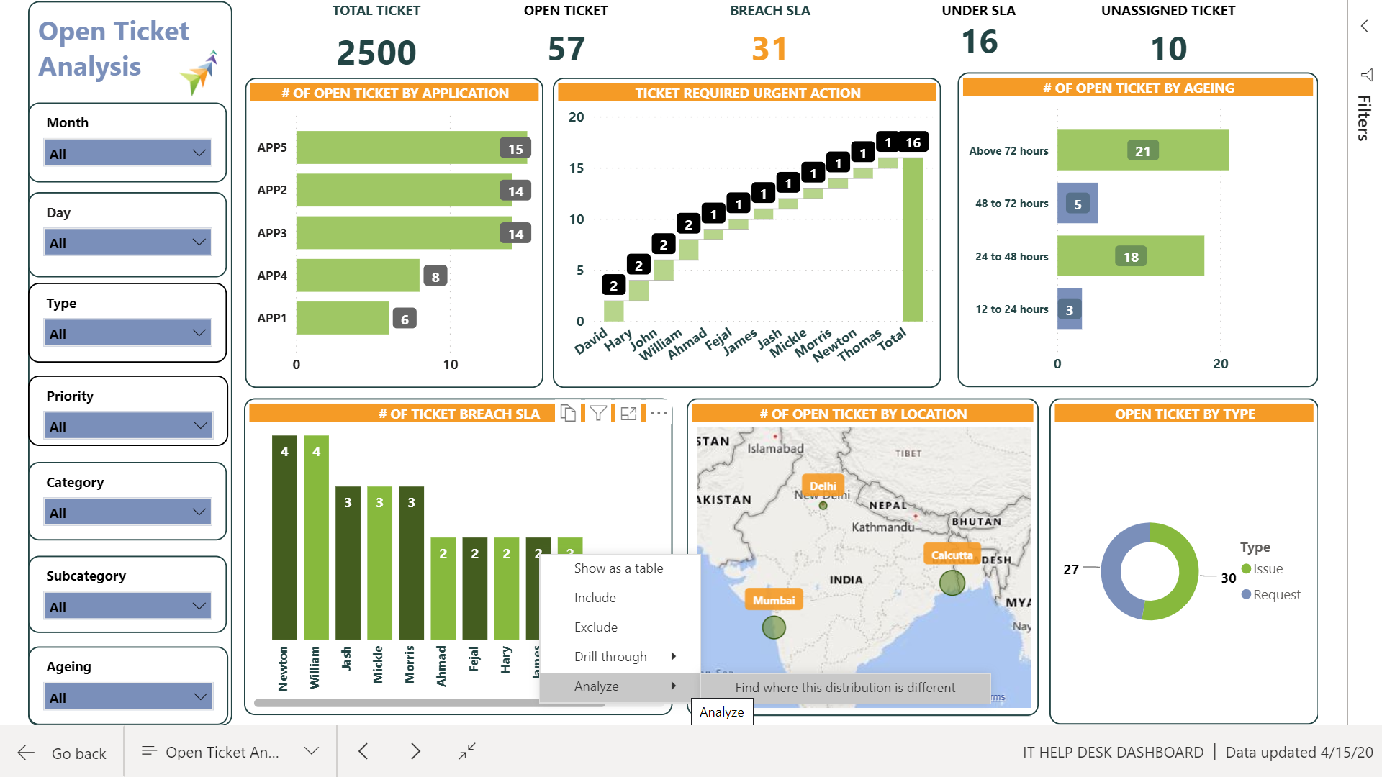

Slide 26
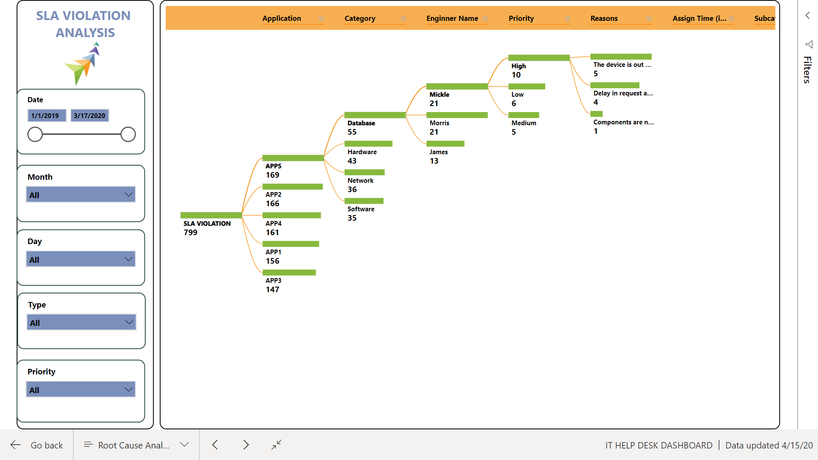

Slide 27
Data Solutions Use Case

Slide 28
Use Case: Data & Analytics Solution
Objective:
Laid foundation and framework for
Enterprise Data Warehouse
Enterprise Data Management
Reporting Automation and Visual Dashboards
Role level security for report data access
Notification features
Enabled the capacity for :-
Operational / MIS Reports – to cater for day to day operations need
Adhoc Reporting – Using OLAP Cubes to provide business users to generate adhoc reports
Data feeds to external entity/sources for further utilization/consumptions
Analytical Reports - using Drill down/Slice And Dice to monitor KPIs effectively
Dashboards – for consolidated view of organization’s performance and portable to mobile devices
Benefit
Reduce manual interference (Automation)
Data Importing process
Standard Report generation and delivery process
Brought in Best Practices in Data Management
Centralized Master Data Management
Data Validation to ensure Data Quality
Data Security at Row and Role level
Data/File Archival and Purging as per company norms
Scalable and Extendable
Integration with new Data Sources.
Quickly built new reports.
Optimal Performance with data growth.

Slide 29











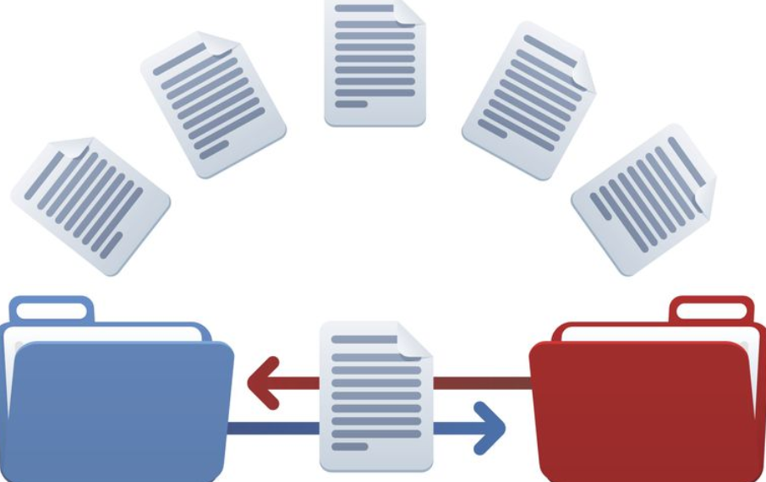




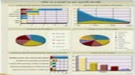
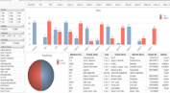
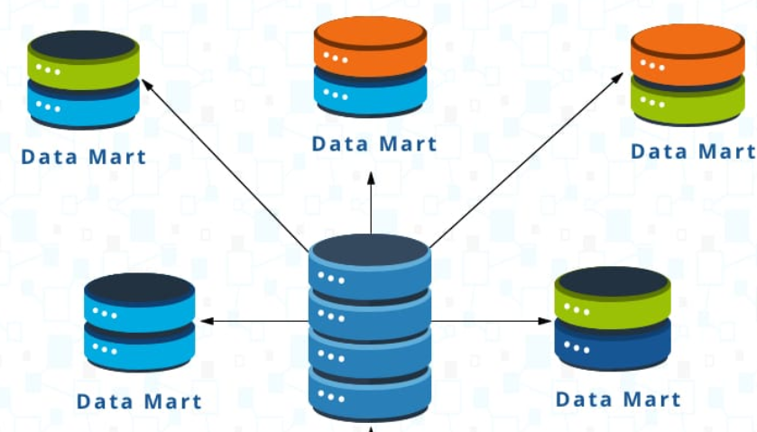
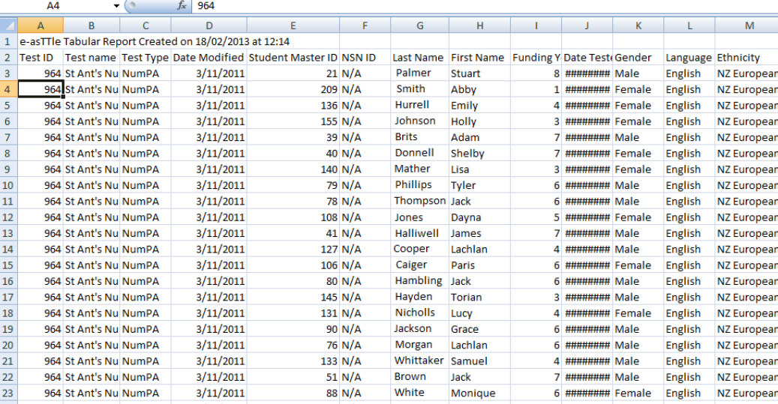
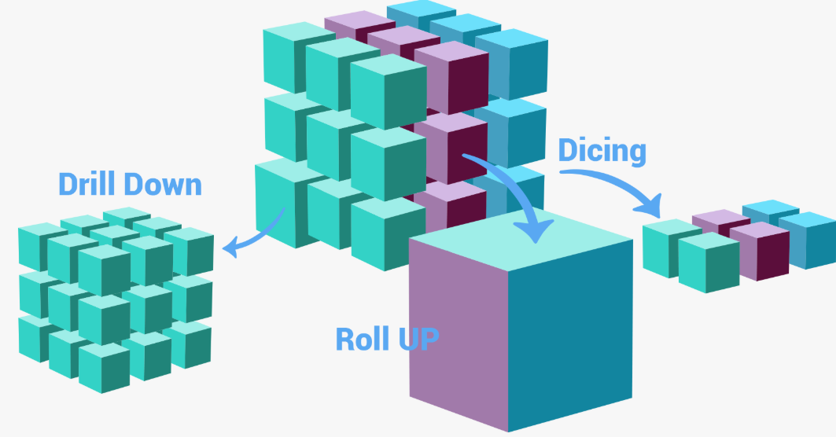
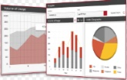
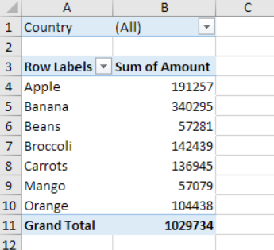
High Level Data Flow
TDT
Data Source
Transaction Disposition tool
Prohance
HRMS
SQL Script
API
Custom Script
Excel Extract
Excel Extract from Email
CSV Extract
File Archival
LANDING
Data Archival
STAGE
REPORTS PRESENTATION LAYER
DATA WAREHOUSE

Slide 30

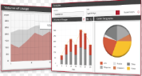

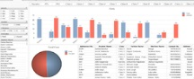









High Level Architecture
Reporting and BI Solution Architecture
INTRANET PORTAL
MS EXCEL – Adhoc Analysis
BUSINESS
USER
REPORTS
MS SSRS
ANALYSIS
MS EXCEL
Conform Dimension
Facts/Measures
MS SSIS
EDW
Enterprise DataWarehouse
SQL SERVER
MS SSIS
OLAP
MS SSAS
Data Marts
Star Schema
STAGING
MDM Staging
Staging
Avaya Staging
ERP Staging
CRM Staging
New Staging
MS SQL SERVER
Jobs Scheduling
SQL Agent
Archived
Archived
0
2
3
4
1
Flat files
Avaya (IVR)
SAP (ERP)
CRM
New Source
MDM
5
SOURCE
DATA

Slide 31
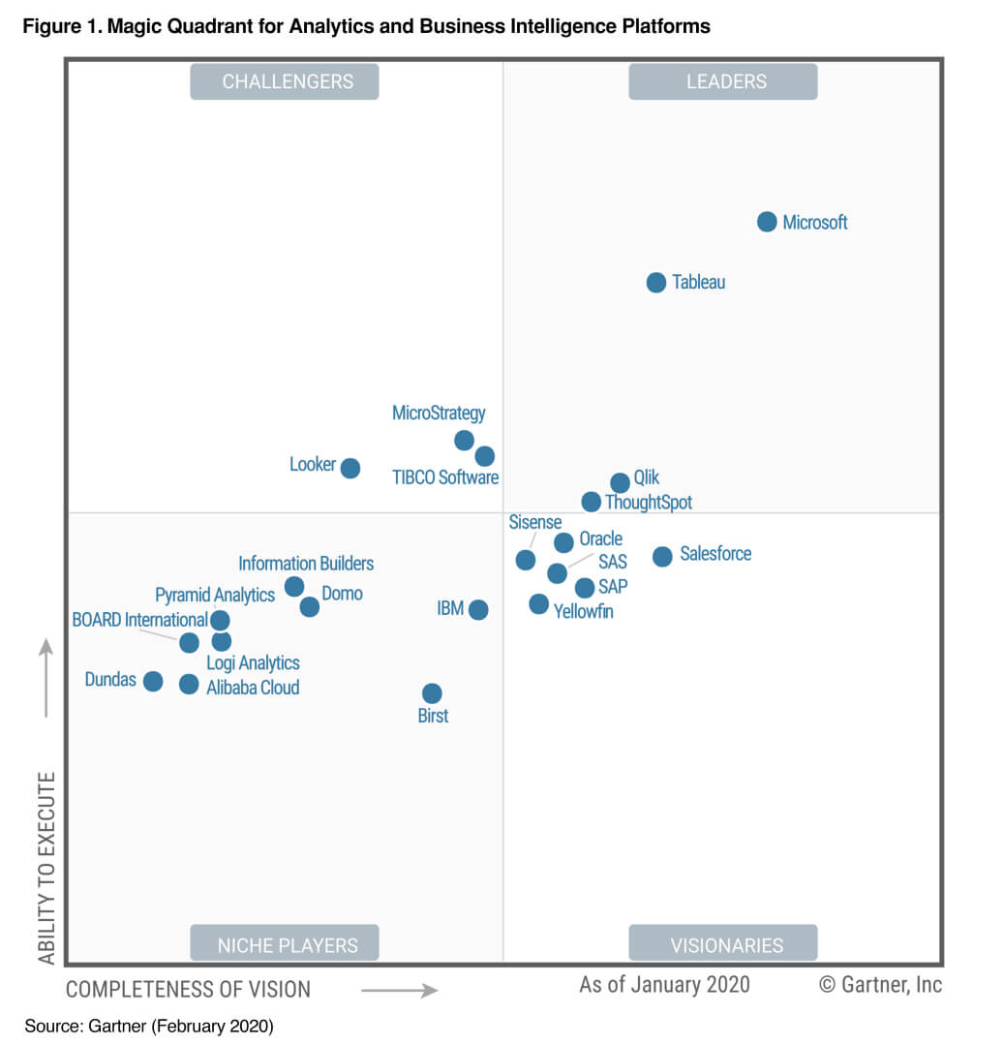
Power BI: The World Leader
Gartner recognizes Microsoft as a Leader for the thirteenth consecutive year in the Gartner 2020 Magic Quadrant for Analytics and Business Intelligent Platforms.

Slide 32
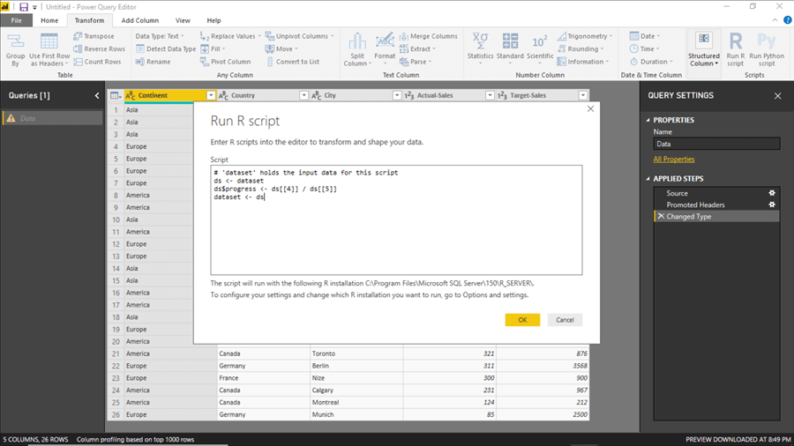
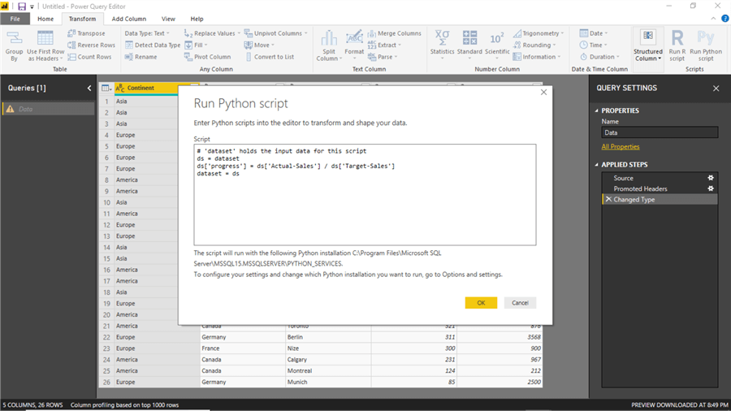
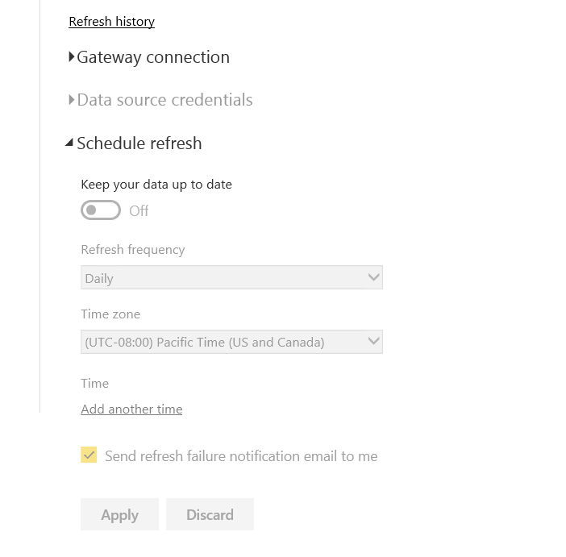
Power BI Key Features
Data Analysis Made Easy: Extract, Transform and Load (ETL) Data with Power BI Desktop
Transform Data in Power BI with R and Python
Schedule Data Refresh: Schedule your data refresh to be daily or even hourly
No manual intervention needed

Slide 33
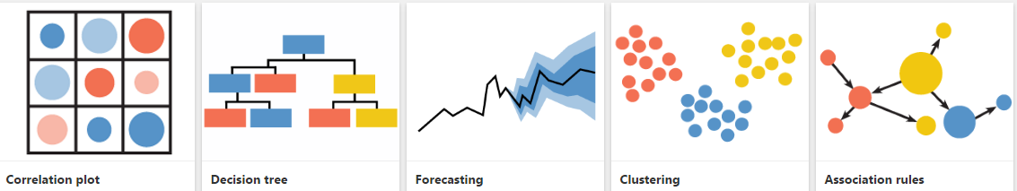
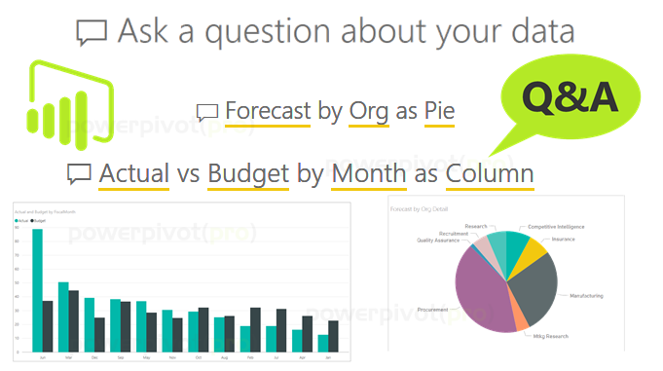
Power BI Key Features
Generate Custom visuals in Power BI using R and Python
Natural Language Q&A: This is one of the most powerful tools in Power BI. Natural Language Q&A allows users to write questions and provides the content and answer, which can be manipulated to match your visual need.

Slide 34
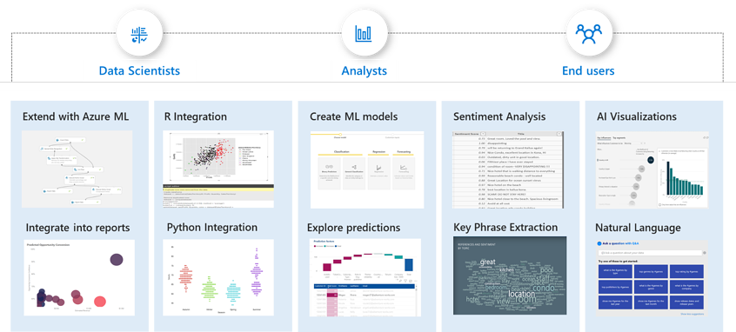
Power BI Key Features
Artificial Intelligence (AI) & Machine Learning (ML) in Power BI

Slide 35
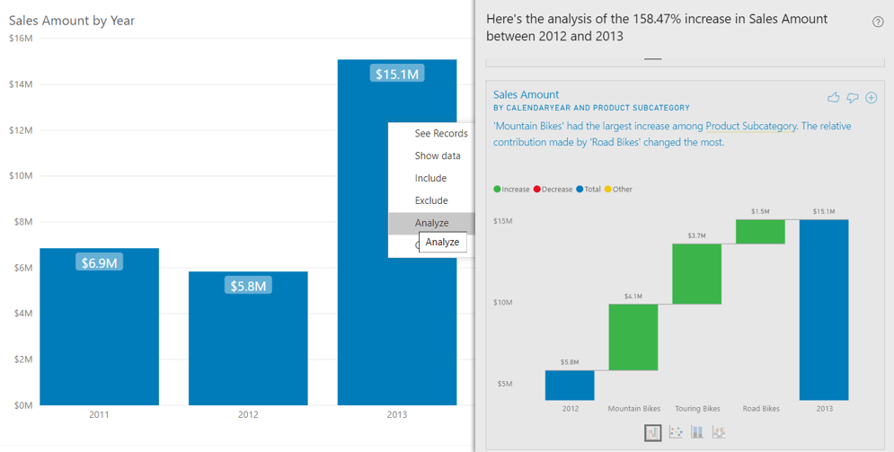
Power BI Key Features
Insights : Explain Increase/Decrease [ Excel does not provide these features]

Slide 36
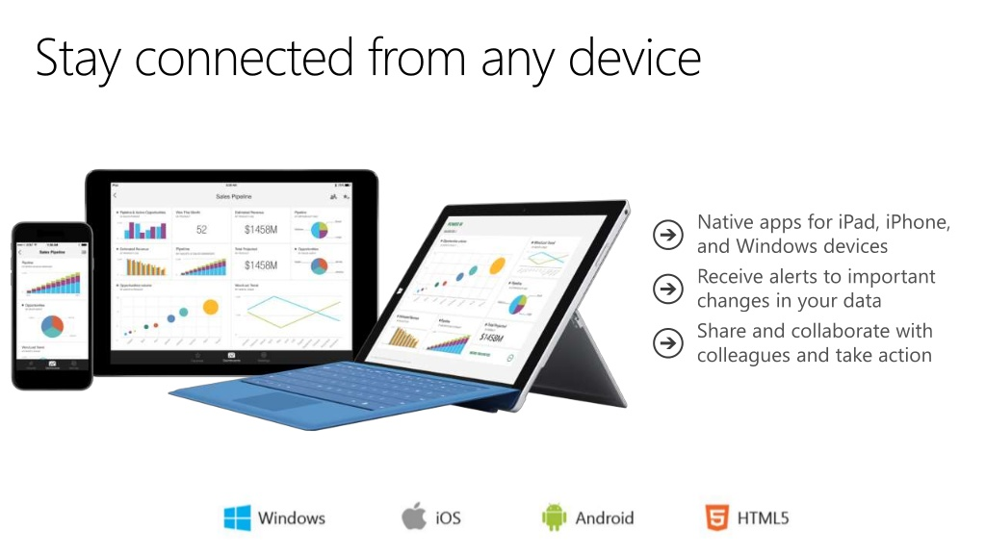
Power BI Key Features
Multiple Device Support

Slide 37

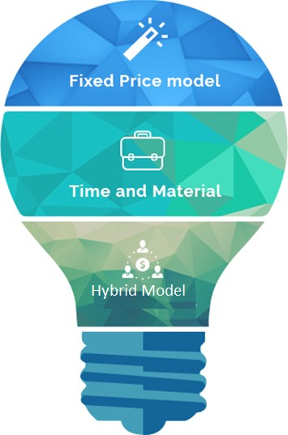



Engagement Model
Scope is Defined and Fixed
Cost is Fixed
Payment on Milestones
Staff Deployed on Client Project
Monthly Billing based on the hours spent by the Staff Deployed
Mix of Fixed Price and T&M

Slide 38



Find Us
@
AKSCELLENCE INFO SOLUTIONS
USA INDIA
901 S. Whitney Way DLF Phase 2, Gurugram
Madison, WI, 53711 Haryana-122002
USA: +1 404 890 6236 INDIA: (0124) 4371756
contact@akscellenceinfo.com

Slide 39
THANK YOU

